Slide 1

Vagrant and Ansible in Action
JULY 5, 2022
Thanh Tung Nguyen & Omar Zeitoun | Internal

Slide 2

Agenda
Initiative Canvas 4
Vagrant 5
Ansible 8
Demo 11

Slide 3

It’s not just about the tech. It’s about changing the way you work.

Slide 4
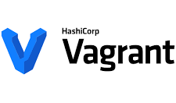

Initiative Canvas
Initiative Goals & Tooling
Initiative GOALS
why it’s worth ADOPTING
Targeting TOOLS
What we try to achieve:
Developers to quickly create development environments that are similar to production in a convenient manner
Deployment code are easy to read, maintain and reuse
A deployment process is standardized, simplified, well documented and facilitates communication and execution
Improvement in performance, security and compliance
Foundation for future automation & CICD
The key issues of the current process:
Manual process of creating development and testing environments
Time and resource consuming for Multi VM replication & documentations
Manual apps deployments with scripts are less secured and make communication & execution complicated
Deployment scripts are difficult to read, maintain and reuse.
Deployment steps are not well documented
Benefits of implementing
Simplify communication, documentation and execution
Improve consistency between development environments and production
Practice DevOps philosophy with tools that allow Infrastructure as Code (IaC)
Enable automation
Strengthen security and compliance
Initiative Canvas
Vagrant
Ansible
Demi

Slide 5

Hello, Vagrant
Here’s a little bit about it.

Slide 6

Vagrant
What is it? Why is it?
Our Expectations
Use Linux on a non-Linux host machine, such as OSX or Windows
Improve consistency between developer environments and deployed servers
Quickly create, destroy and recreate VM’s for development purposes
Current Problems with VM Management
Manual VM Setup and OS Installation
Time & Resource Consuming
Tough Replication & Documentations for Multi VM
Virtualization
Virtualization allows multiple operating systems to simultaneously share processor resources in a safe and efficient manner.
Vagrant’s Offerings
VM and OS Setup through Images (Vagrant Boxes) available in Vagrant Cloud
Managing VM’s and their OS with a file (Vagrantfile) means Version Control
Spinning up and tearing down VM’s in minutes with simple commands
tool for building complete development environments
Initiative Canvas
Vagrant
Ansible
Demo

Slide 7

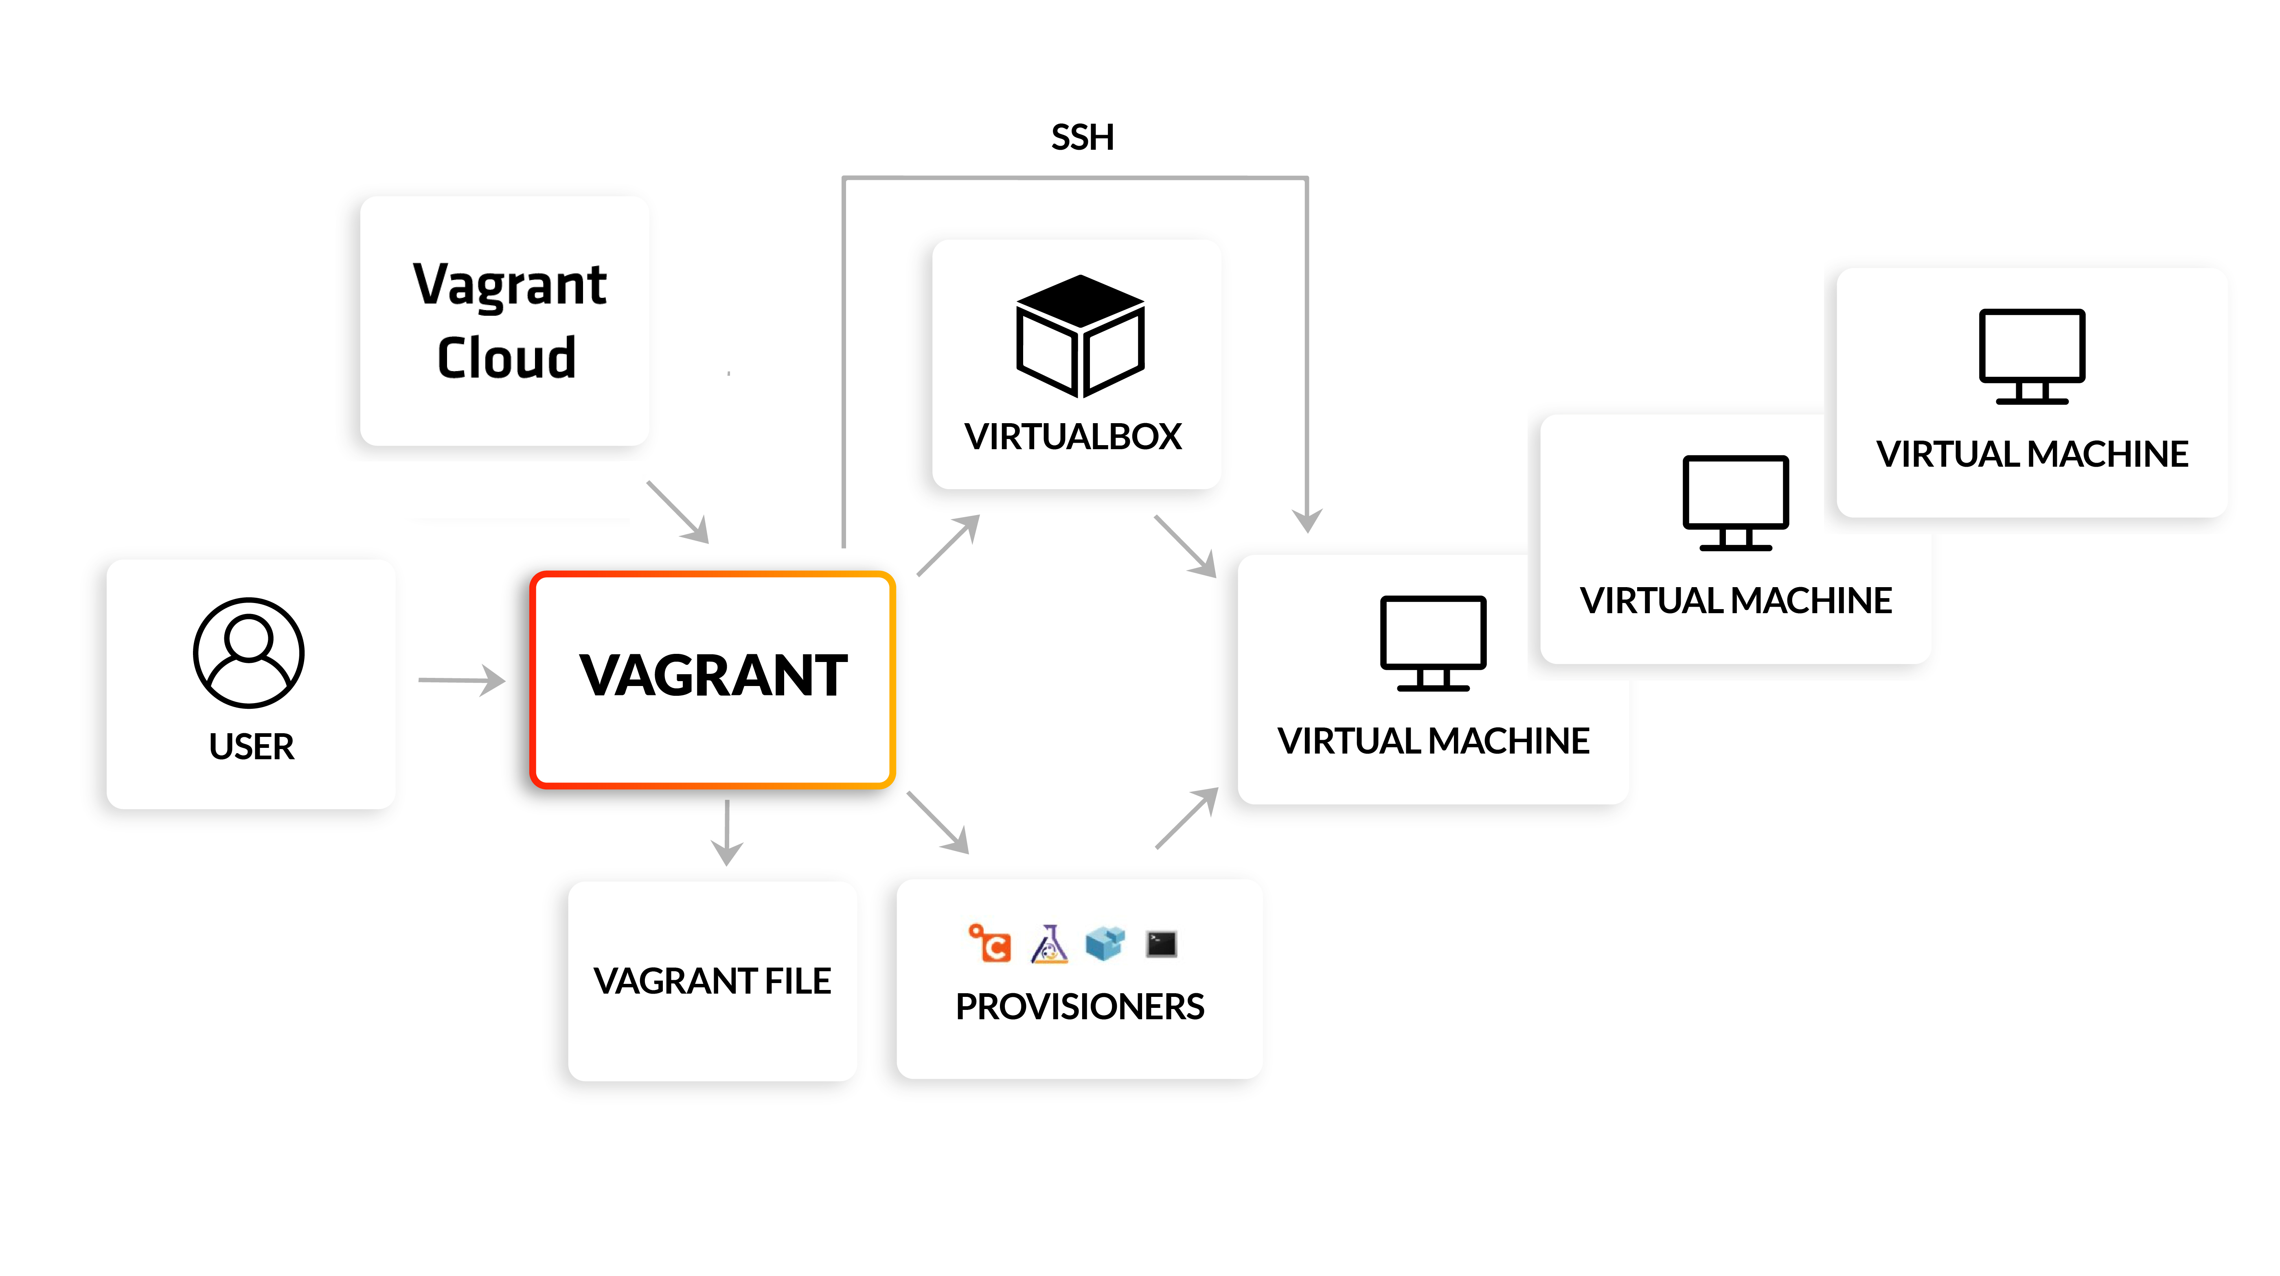
Vagrant
Workflow
# simple commands
$ vagrant up
$ vagrant halt/reload/destroy
$ vagrant ssh
Initiative Canvas
Vagrant
Ansible
Demo
# IaC with Vagrantfile
virtual machine info
networking
provisioning
etc,..

Slide 8

What about Ansible?

Slide 9

Ansible
What is it? Why is it?
Our Expectations
Efficient way to automate repetitive tasks on multiple machines/hosts (i.e.: update / back up / create users / deploy apps)
Current Practices
Manual/Semi-automated app deployments with bash scripts that requires manual logins to hosts one after another and file transferring between hosts
Ansible’s Offerings
Execute tasks from your own computer or from a remote machine (jump box)
Configuration/Installation/Deployment steps in a single YAML file (instead of manual or shell scripts)
Re-use same file multiple times for different environments
More reliable and less likely for errors (little to none human interactions)
Support all infrastructure (from operating systems to cloud providers, from VM to bare metal)
Ansible’s Key Tenets
Declarative but procedural in nature (what tasks to be done in order)
Agent-less (no need to install agents on servers) – more secured and no upgrade effort
Idempotent (an operation can be run multiple times without changing the initial application AKA executing your playbook multiple times without breaking its prior successful runs AKA it knows what has been done and what is needed to be done)
Community driven (someone out there that has already done it for you) – Ansible Galaxy – BUT YOU NEED TO TEST IT
the simplest way to automate apps and IT infrastructure (provision, config management, etc.)
Initiative Canvas
Vagrant
Ansible
Demo

Slide 10
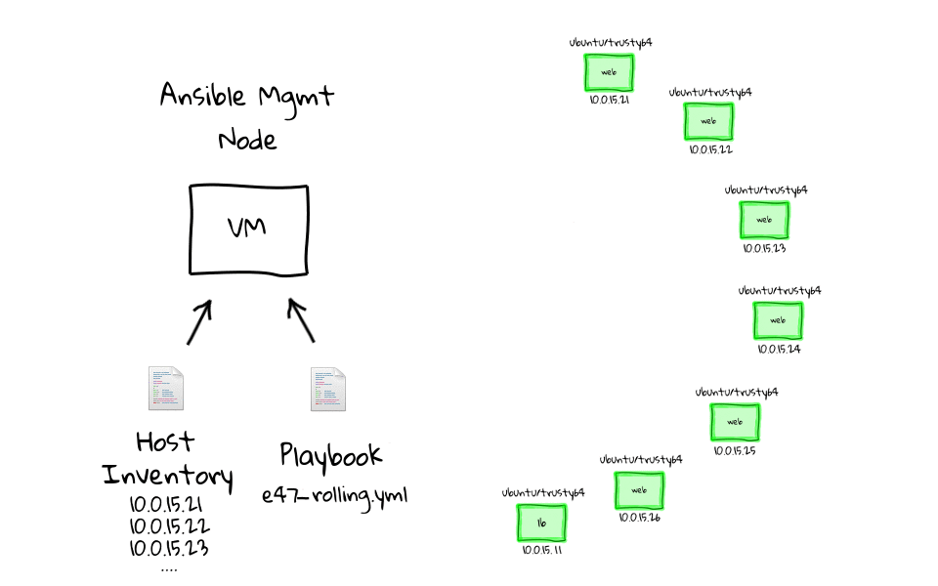
Ansible
your local computer OR a remote machine (jump box)
Workflow
Initiative Canvas
# deploy with a single command & no login required
$ ansible-playbook ./site.yml -i ./inventory.yml
# encrypting secrets instead of exposing them
$ ansible-vault encrypt host_vars/all/vault.yml
# flexibly run tasks and blocks with tags
$ ansible-playbook ./site.yml -i ./vagrant.test.ini --tags "config-telegraf"
Vagrant
Ansible
Demo
can be grouped (by functionality OR location OR your preference)
different files for different environments (dev.yml OR test.yml)
plays instead of scripts (more intuitive)
.yaml instead of .sh (easier to read)
declarative programming (what is to be done instead of how)
can be modulated with Roles
plays maps tasks with groups of hosts (flexibly decide what to do with specific host)

Slide 11

Time for a Demo

Slide 12
Thank you.
Thanh Tung Nguyen
Data Engineer, EVLO Energy
Contact: nguyen.thanhtung@evloenergie.com
Omar Zeitoun
Team Lead , EVLO Energy
Contact: zeitoun.omar@evloenergie.com

